Slide 1

HNDIT2417
Mobile Application Development
www.hndit.com
Week1&2- Introduction to Mobile Application Development & Android Studio

Slide 2
Outline
www.hndit.com
Introduction to Android
Getting Started
Creating First Android Project

Slide 3
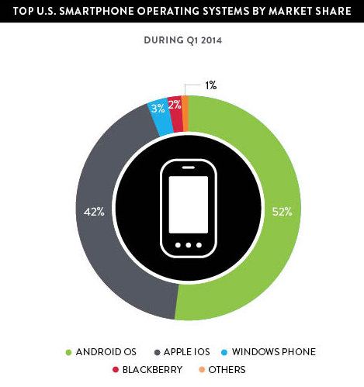
Introduction to Android
www.hndit.com
Popular mobile device OS: 52% of U.S. smartphone market [8]
Developed by Open Handset Alliance, led by Google
Google claims 900,000 Android device activations [9]
Source: [8]

Slide 4
What is Android
www.hndit.com
Android is an operating system for mobile devices such as smartphones and tablet computers. It is developed by the Open Handset Alliance led by Google.
Android has beaten Apple iOS, being the leading mobile operating system from first quarter of 2011
Version: Android 1.0, 1.1 to 1.5 (Cupcake), 1.6 (Donut), 2.0/2.1 (Eclair), 2.2 (Froyo), 2.3 (Gingerbread), to 3.0 (Honeycomb), 4.0 (Ice Cream Sandwich), 5.0 (Lollipop)

Slide 5
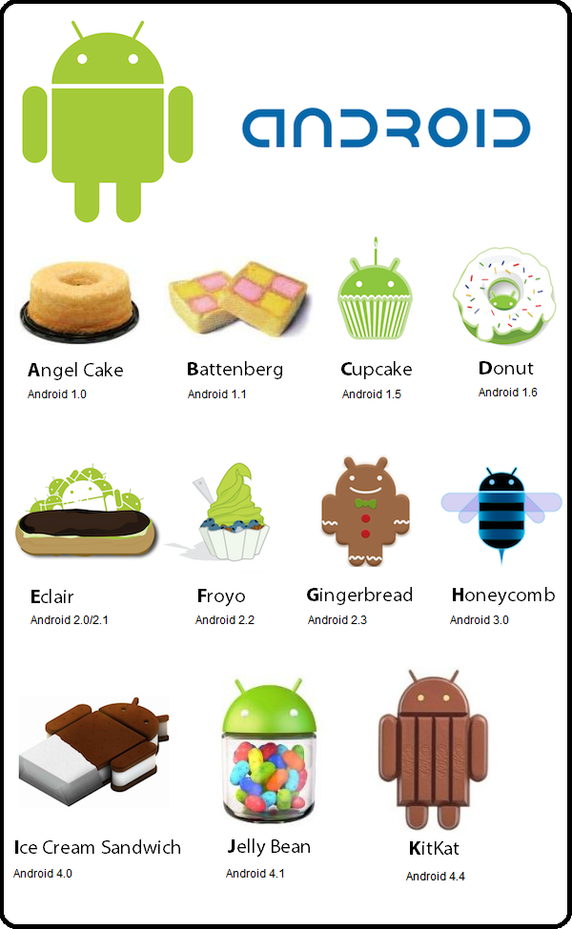
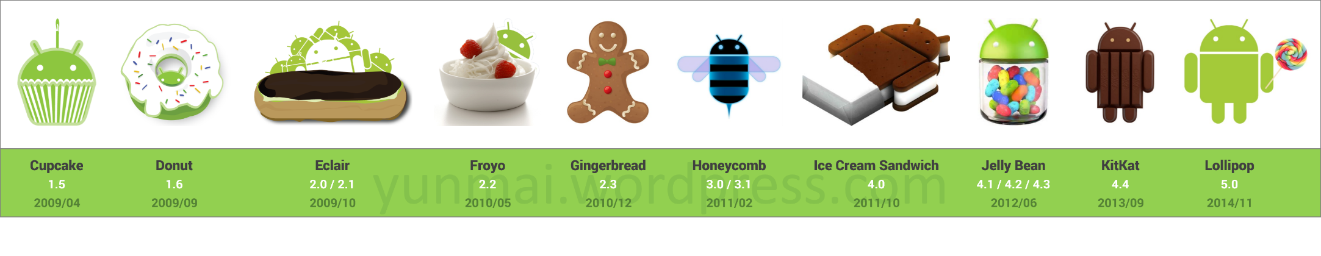
www.hndit.com

Slide 6
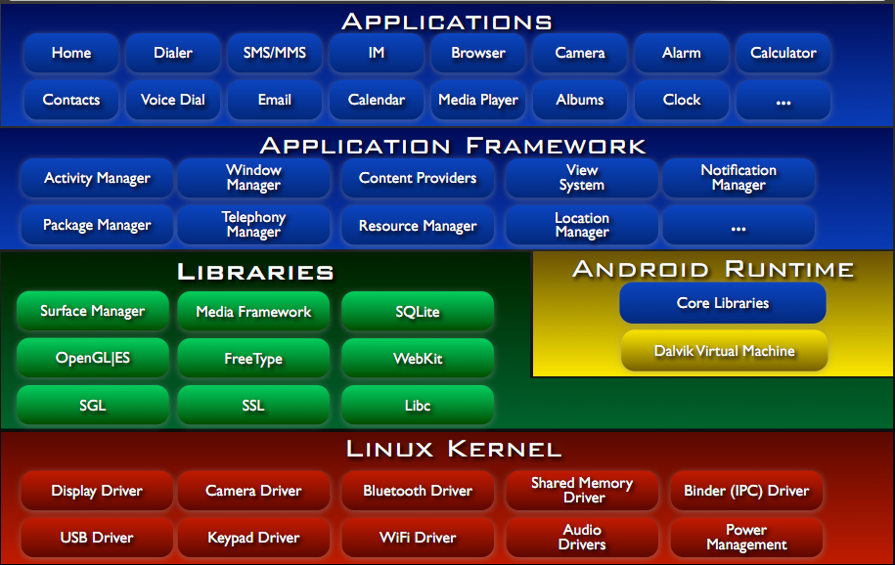
Android Architecture
www.hndit.com

Slide 7
Outline
www.hndit.com
Introduction to Android
Getting Started
Android Programming

Slide 8
Getting Started (1)
www.hndit.com
Need to install Java Development Kit (JDK) to write
Java (and Android) programs
  Do not install Java Runtime Environment (JRE);
  JDK and JRE are different!
Can download the JDK for your OS at http://java.oracle.com
Alternatively, for OS X, Linux:
  OS X:
    Open /Applications/Utilities/Terminal.app
    Type javac at command line
    Install Java when prompt appears
  Linux:
    Type sudo apt–get install default–jdk at command line
    (Debian, Ubuntu)
    Other distributions: consult distribution’s documentation

Slide 9
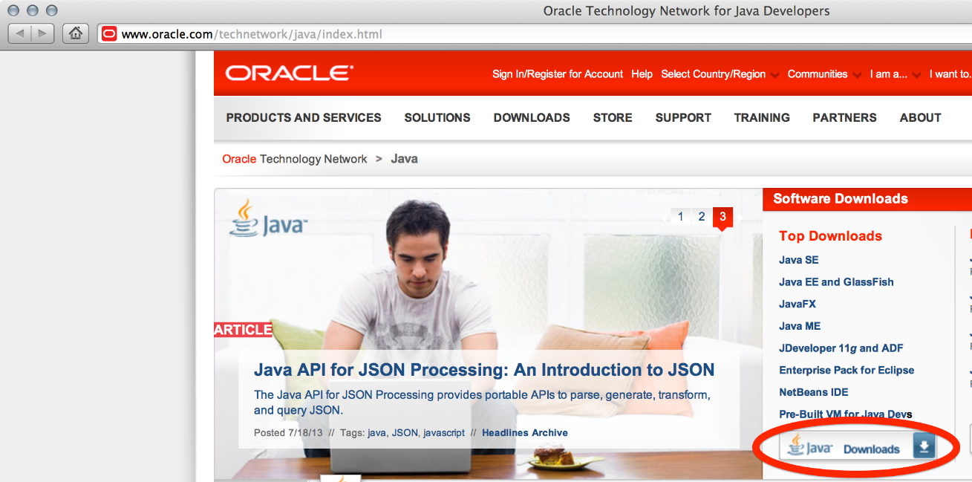

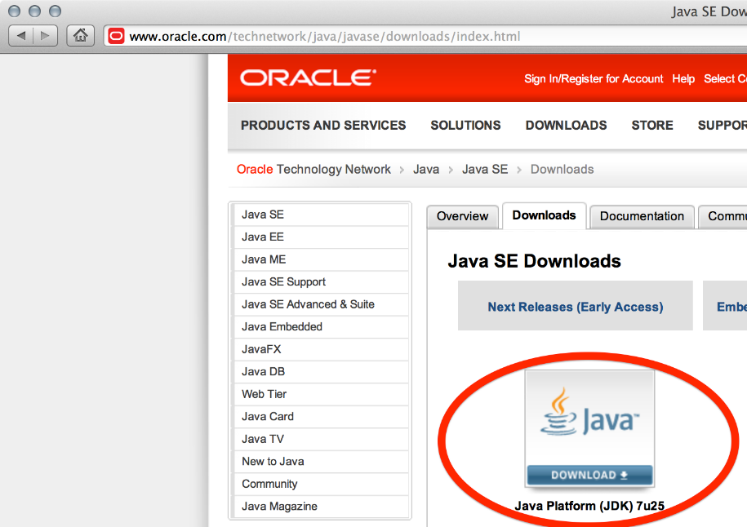
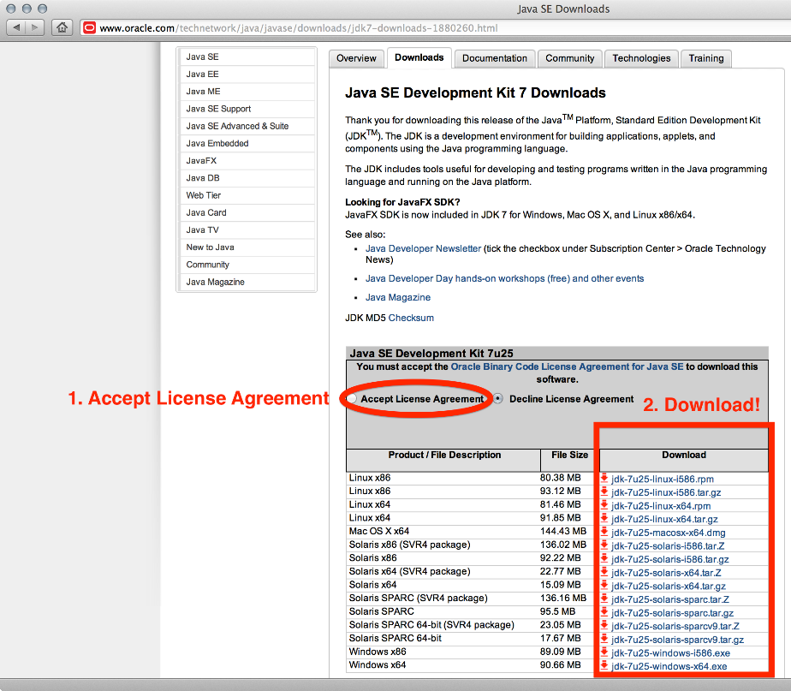
www.hndit.com
Install!

Slide 10
Getting Started (2)
www.hndit.com
After installing JDK, download Android SDK from http://developer.android.com
Simplest: download and install Android Studio bundle (including Android SDK) for your OS
Alternatives:
  Download/install Android Developer Tools from this site (based on Eclipse)
  Install Android SDK tools by themselves, then install ADT for Eclipse separately (from this site)
We’ll use Android Studio with SDK included (easy)

Slide 11
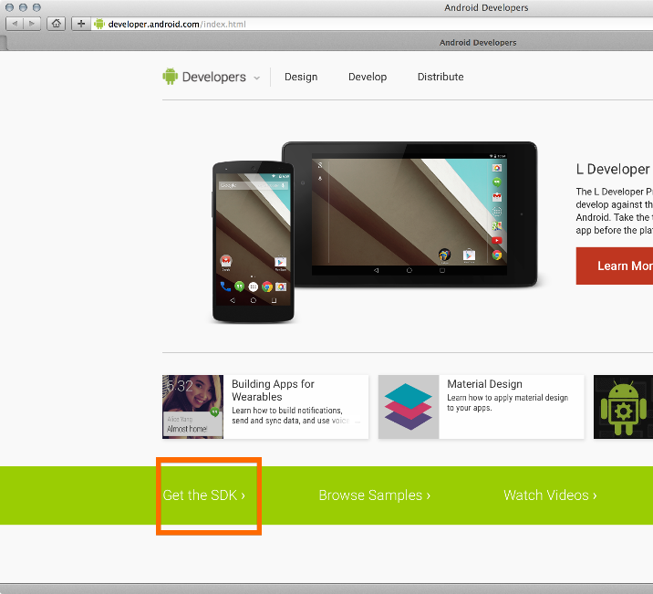
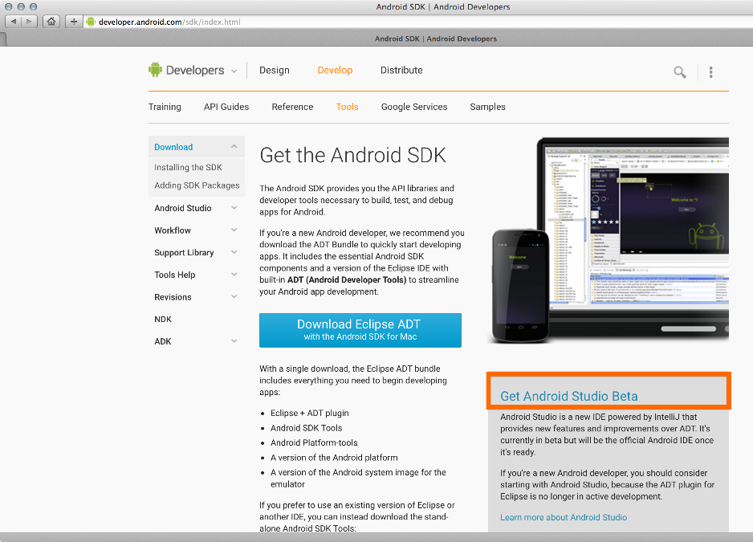
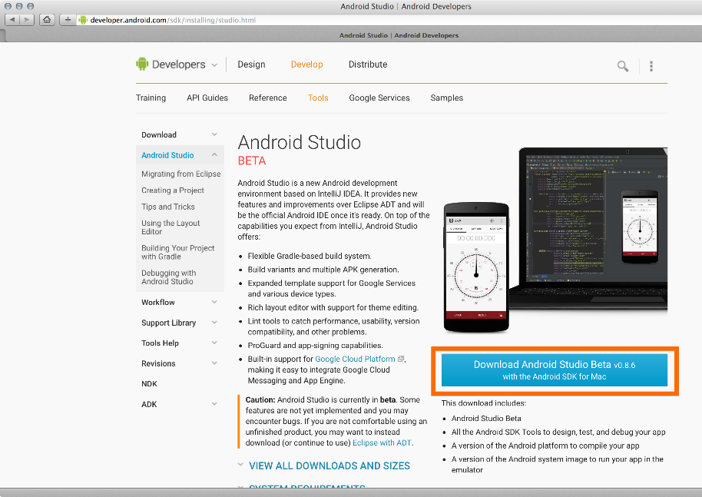
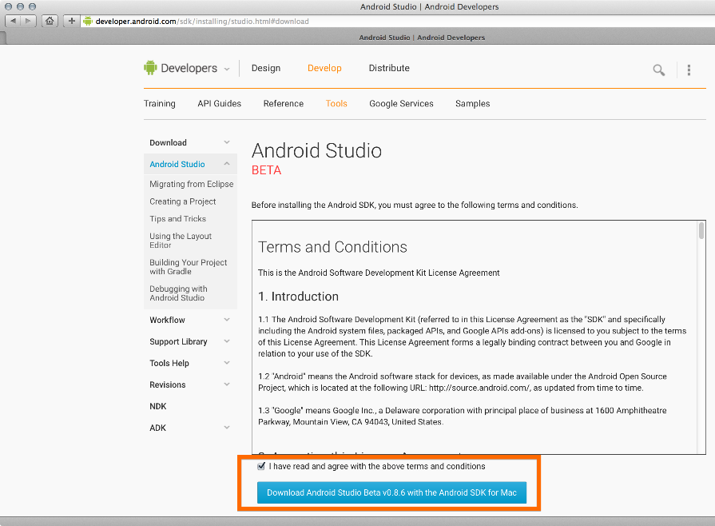
www.hndit.com
Install!

Slide 12
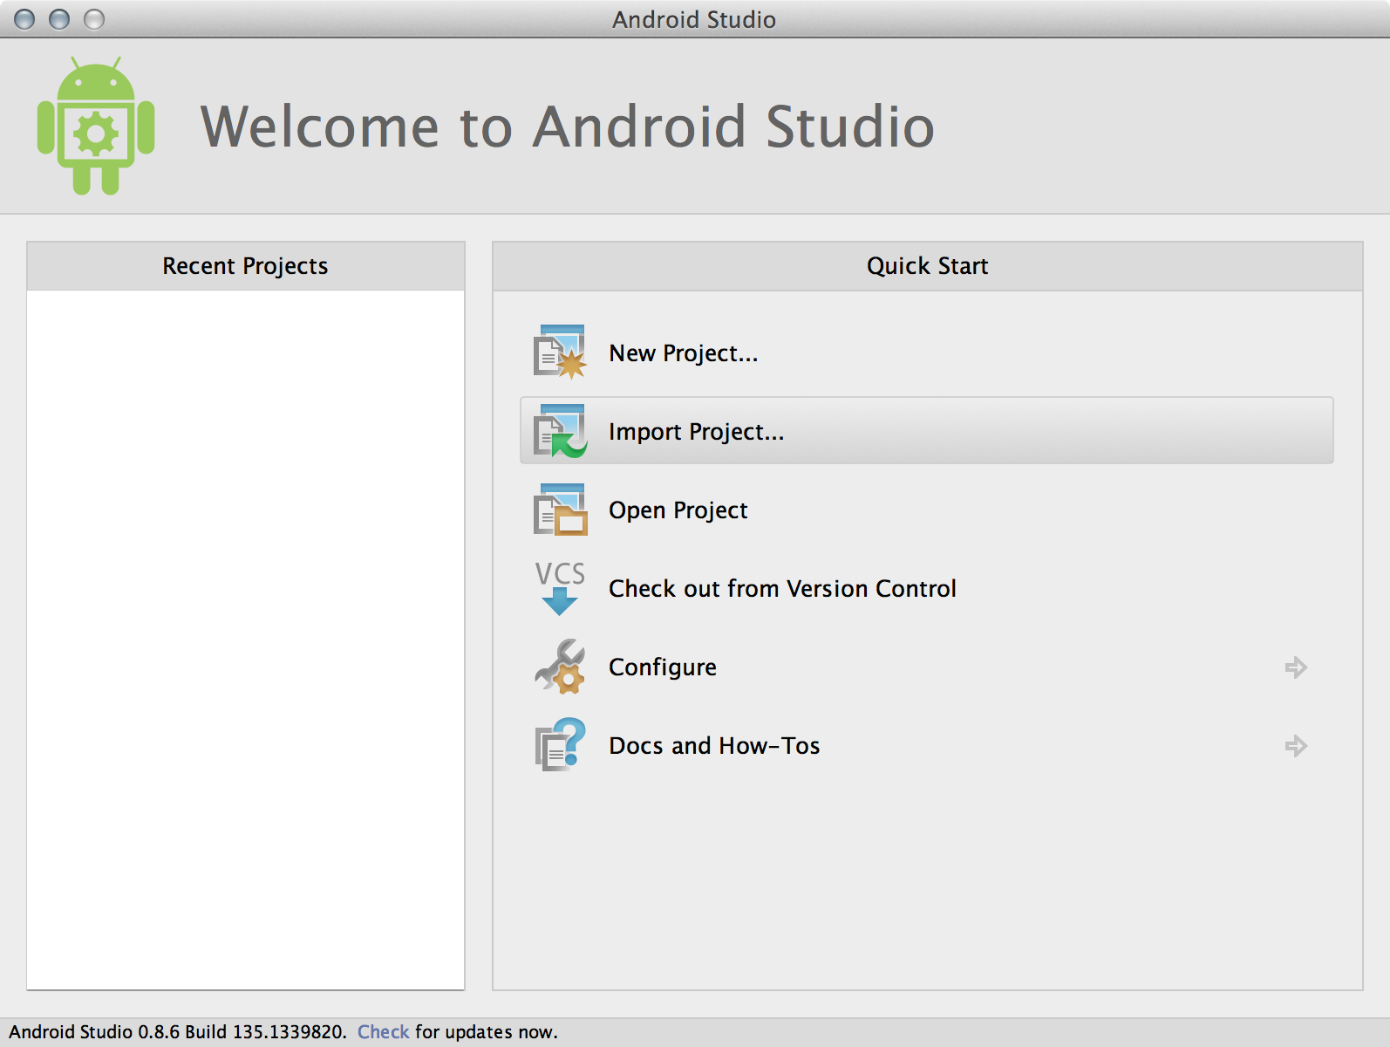
Getting Started (3)
www.hndit.com
Install Android Studio directly (Windows, Mac); unzip to directory android-studio, then run ./android-studio/bin/studio.sh (Linux)
You should see this:

Slide 13
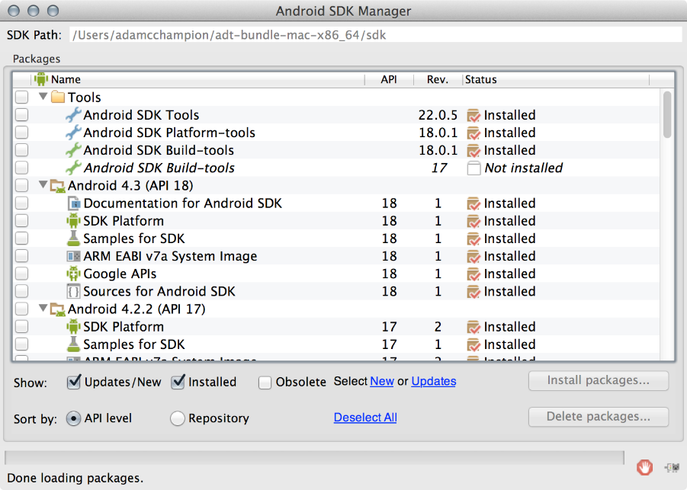
Getting Started (4)
www.hndit.com
Strongly recommend testing with real Android device
  Android emulator: very slow
  Faster emulator: Genymotion [14], [15]
  Install USB drivers for your Android device!
Bring up the Android SDK Manager
  Recommended: Install Android 2.2, 2.3.3 APIs and 4.x API
  Do not worry about Intel x86 Atom, MIPS system images
Settings
Now you’re ready for Android development!

Slide 14
Outline
www.hndit.com
Introduction to Android
Getting Started
Android Programming

Slide 15
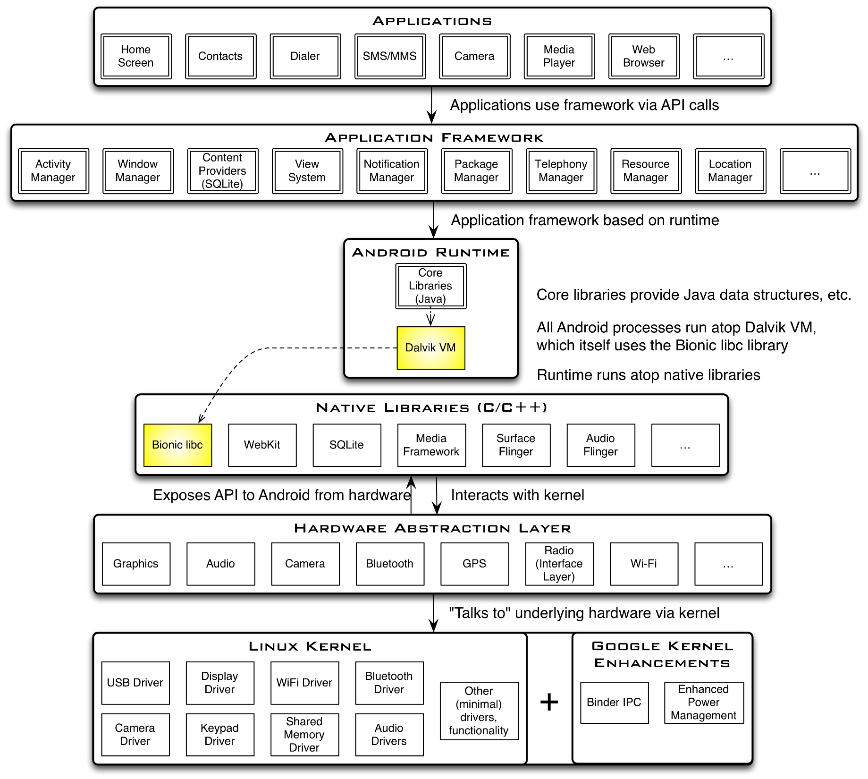
www.hndit.com

Slide 16
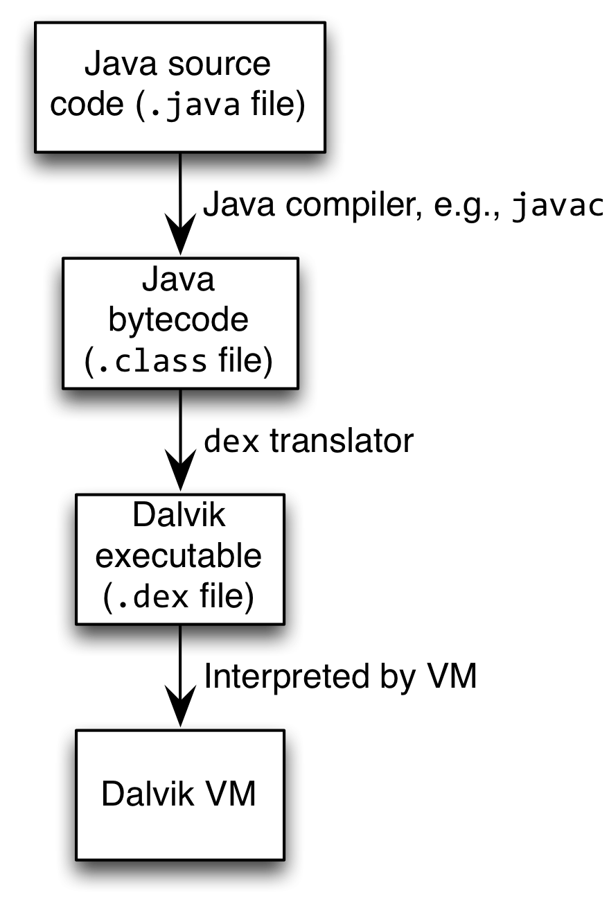
Android Highlights (1)
www.hndit.com
Android apps execute on Dalvik VM, a “clean-room” implementation of JVM
  Dalvik optimized for efficient execution
  Dalvik: register-based VM, unlike Oracle’s stack-based JVM
  Java .class bytecode translated to Dalvik EXecutable (DEX) bytecode, which Dalvik interprets

Slide 17
Android Highlights (2)
www.hndit.com
Android apps written in Java 5
  Actually, a Java dialect (Apache Harmony)
  Everything we’ve learned still holds
Apps use four main components:
  Activity: A “single screen” that’s visible to user
  Service: Long-running background “part” of app (not separate process or thread)
  ContentProvider: Manages app data (usually stored in database) and data access for queries
  BroadcastReceiver: Component that listens for particular Android system “events”, e.g., “found wireless device”, and responds accordingly

Slide 18
App Manifest
www.hndit.com
Every Android app must include an AndroidManifest.xml file describing functionality
The manifest specifies:
  App’s Activities, Services, etc.
  Permissions requested by app
  Minimum API required
  Hardware features required, e.g., camera with autofocus
  External libraries to which app is linked, e.g., Google Maps library

Slide 19
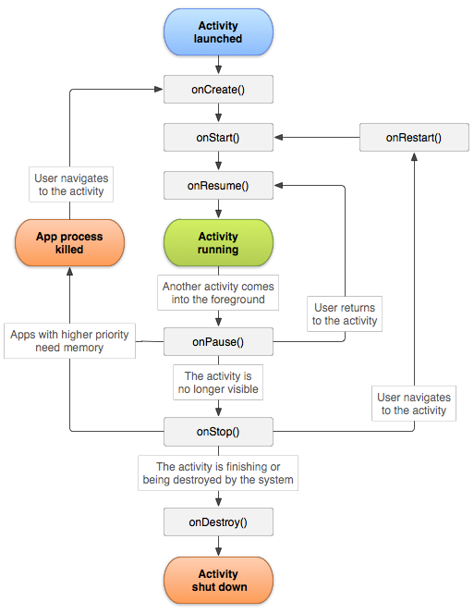
Activity Lifecycle
www.hndit.com
Activity: key building block of Android apps
Extend Activity class, override onCreate(), onPause(), onResume() methods
Dalvik VM can stop any Activity without warning, so saving state is important!
Activities need to be “responsive”, otherwise Android shows user “App Not Responsive” warning:
  Place lengthy operations in Runnable Threads, AsyncTasks
Source: [12]

Slide 20
App Creation Checklist
www.hndit.com
If you own an Android device:
  Ensure drivers are installed
  Enable developer options on device under Settings, specifically USB Debugging
    Android 4.2+: Go to Settings→About phone, press Build number 7 times to enable developer options
For Android Studio:
  Under File→Settings→Appearance, enable “Show tool window bars”; the Android view shows LogCat, devices
  Programs should log states via android.util.Log’s Log.d(APP_TAG_STR, “debug”), where APP_TAG_STR is a final String tag denoting your app
  Other commands: Log.e() (error); Log.i() (info); Log.w() (warning); Log.v() (verbose) – same parameters

Slide 21
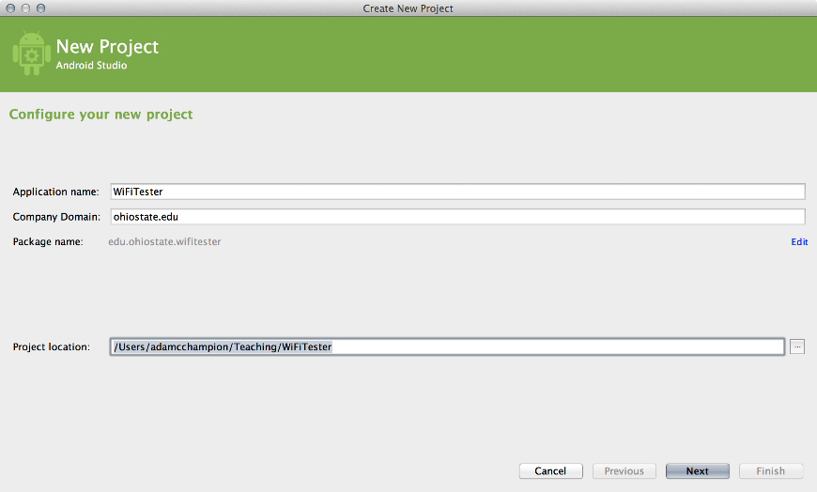
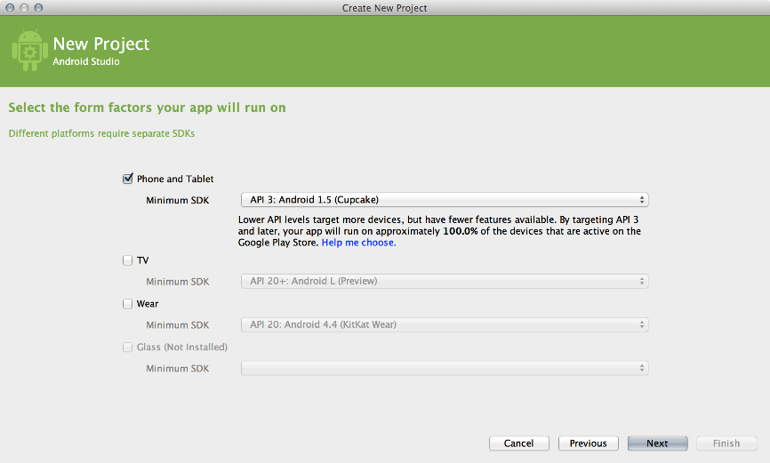
Creating Android App (1)
www.hndit.com
Creating Android app project in Android Studio:
  Go to File→New Project
  Enter app, project name
  Choose package name using “reverse URL” notation, e.g., edu.osu.myapp
  Select APIs for app, then click Next

Slide 22
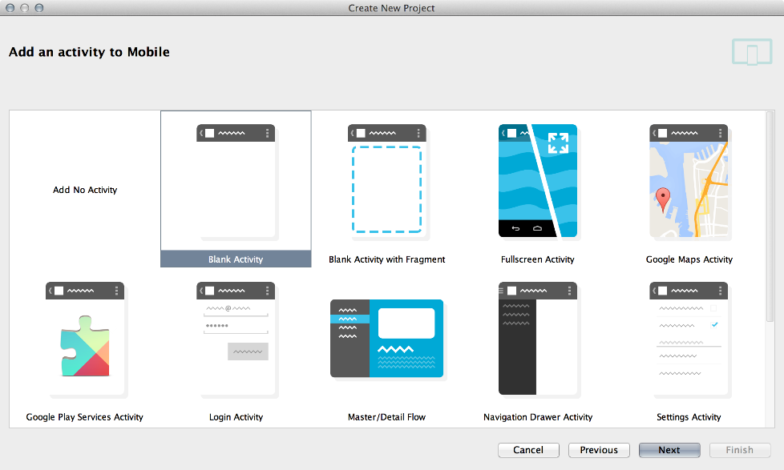
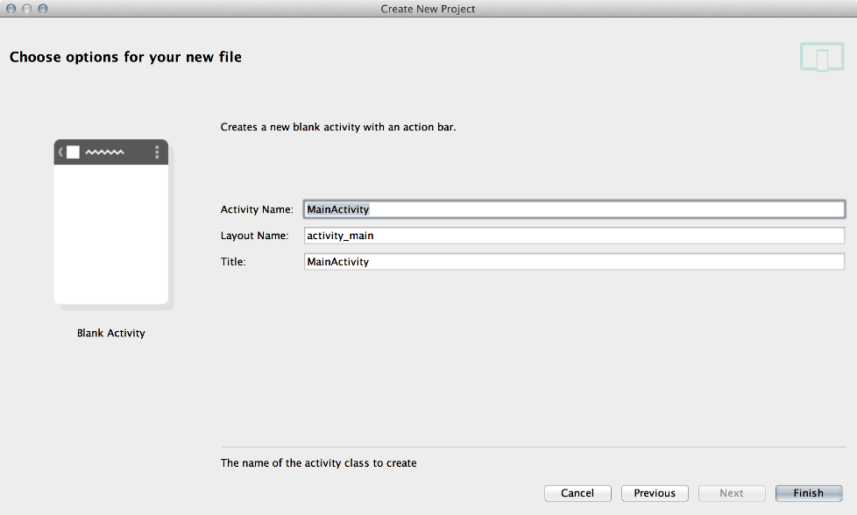
Creating Android App (2)
www.hndit.com
Determine what kind of Activity to create; then click Next
  We’ll choose a Blank Activity for simplicity
Enter information about your Activity, then click Finish
This creates a “Hello World” app

Slide 23
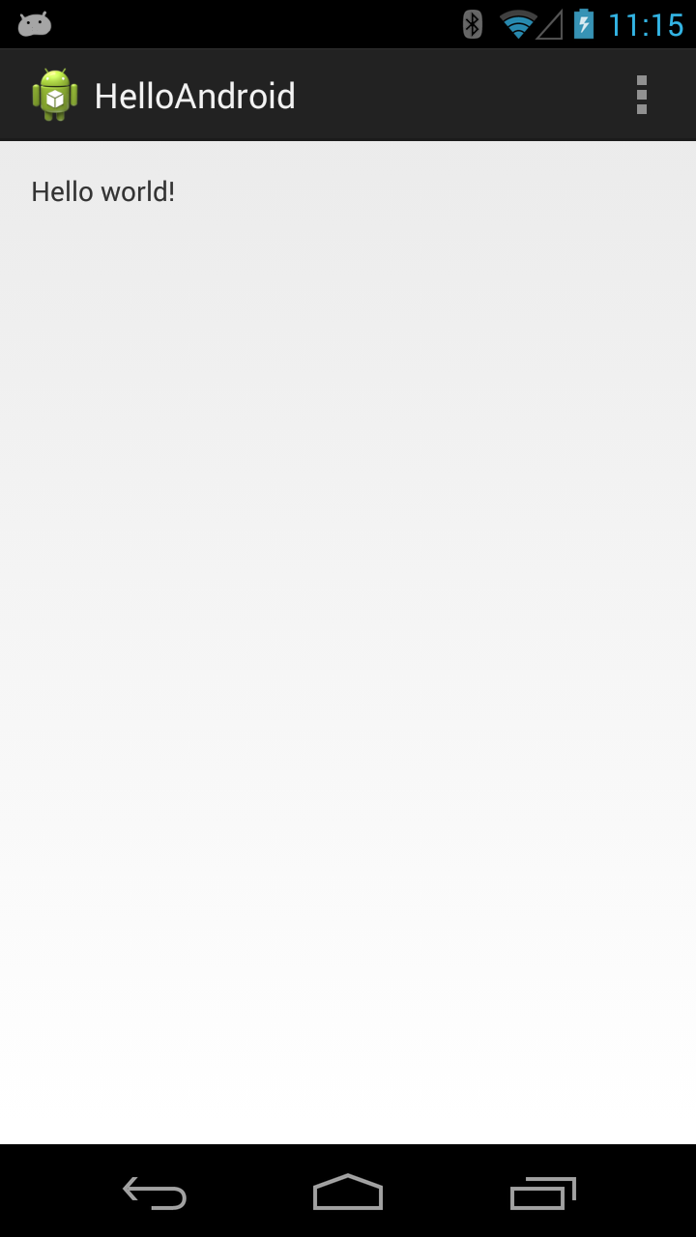
Deploying the App
www.hndit.com
Two choices for deployment:
  Real Android device
  Android virtual device
Plug in your real device; otherwise, create an Android virtual device
Emulator is slow. Try Intel accelerated version, or perhaps
http://www.genymotion.com/
Run the app: press “Run” button in toolbar

Slide 24
Underlying Source Code
www.hndit.com
src/…/MainActivity.java
package edu.osu.helloandroid;
import android.os.Bundle;
import android.app.Activity;
import android.view.Menu;
public class MainActivity extends Activity
{
@Override
protected void onCreate(Bundle savedInstanceState)
{
super.onCreate(savedInstanceState);
setContentView(R.layout.activity_main);
}
@Override
public boolean onCreateOptionsMenu(Menu menu)
{
// Inflate the menu; this adds items to the action bar if it is present.
getMenuInflater().inflate(R.menu.main, menu);
return true;
}
}

Slide 25
Underlying GUI Code
www.hndit.com
res/layout/activity_main.xml
<RelativeLayout xmlns:android="http://schemas.android.com/apk/res/android"
xmlns:tools="http://schemas.android.com/tools"
android:layout_width="match_parent"
android:layout_height="match_parent"
android:paddingBottom="@dimen/activity_vertical_margin"
android:paddingLeft="@dimen/activity_horizontal_margin"
android:paddingRight="@dimen/activity_horizontal_margin"
android:paddingTop="@dimen/activity_vertical_margin"
tools:context=".MainActivity" >
<TextView
android:layout_width="wrap_content"
android:layout_height="wrap_content"
android:text="@string/hello_world" />
</RelativeLayout>
– RelativeLayouts are quite complicated. See [13] for details

Slide 26
The App Manifest
www.hndit.com
AndroidManifest.xml
<?xml version="1.0" encoding="utf-8"?>
<manifest xmlns:android="http://schemas.android.com/apk/res/android"
package="edu.osu.helloandroid"
android:versionCode="1"
android:versionName="1.0" >
<uses-sdk
android:minSdkVersion="8"
android:targetSdkVersion="17" />
<application
android:allowBackup="true"
android:icon="@drawable/ic_launcher"
android:label="@string/app_name"
android:theme="@style/AppTheme" >
<activity
android:name="edu.osu.helloandroid.MainActivity"
android:label="@string/app_name" >
<intent-filter>
<action android:name="android.intent.action.MAIN" />
<category android:name="android.intent.category.LAUNCHER" />
</intent-filter>
</activity>
</application>
</manifest>

Slide 27
Android Programming Notes
www.hndit.com
Android apps have multiple points of entry: no main() method
  Cannot “sleep” in Android
  During each entrance, certain Objects may be null
  Defensive programming is very useful to avoid crashes, e.g.,
  if (!(myObj == null)) { // do something }
Java concurrency techniques are required
  Don’t block the “main” thread in Activities
  Implement long-running tasks such as network connections asynchronously, e.g., as AsyncTasks
  Recommendation: read [4]; chapter 20 [10]; [11]
Logging state via android.util.Log throughout app is essential when debugging (finding root causes)
Better to have “too many” permissions than too few
  Otherwise, app crashes due to security exceptions!
  Remove “unnecessary” permissions before releasing app to public
Event handling in Android GUIs entails many listener Objects

Slide 28
Thank You
Any questions?
www.hndit.com

